Slide 1
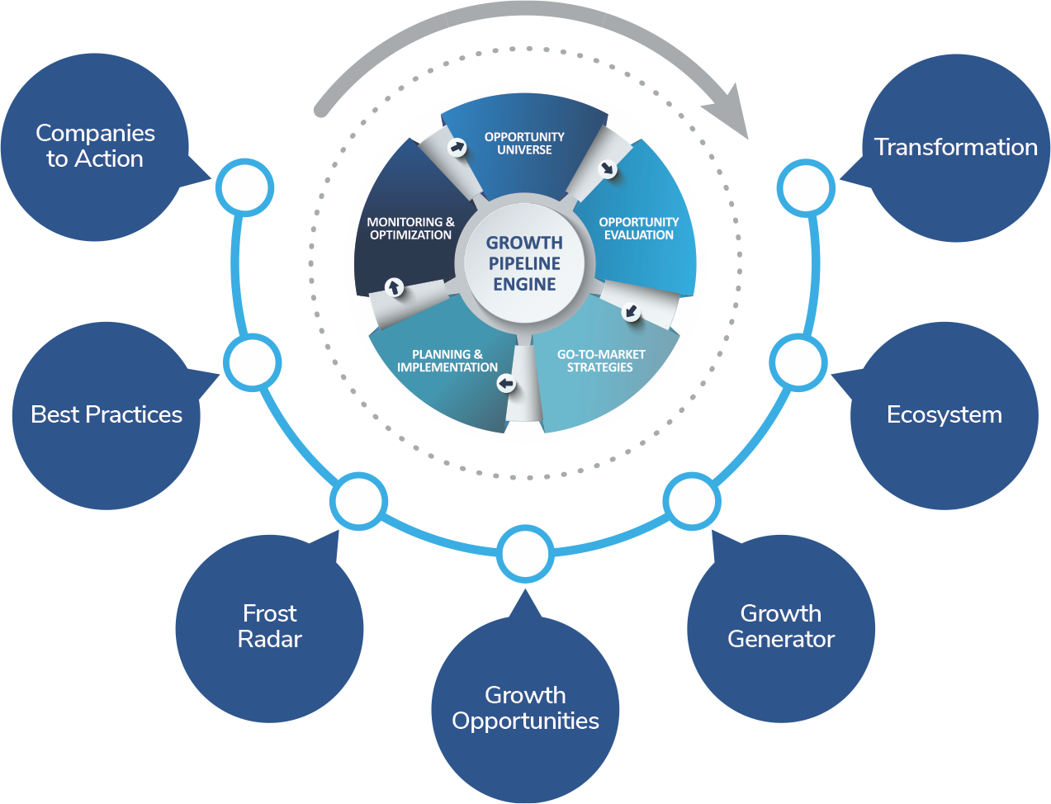
TRANSFORMATIONAL GROWTH JOURNEY
“Powered by the Growth Pipeline Engine”
Proposal
For
Project Evaluation & Recognition Program (PERP)
For 2026
Is your team prepared for the coming Transformation?

Slide 2
NOMINATION DETAILS

Slide 3
Project Evaluation Recognition Program (PERP) Application Details
Project 1
PROJECT TITLE:
PROJECT CATEGORY:
PROJECT CHAMPION:
Project 2
PROJECT TITLE:
PROJECT CATEGORY:
PROJECT CHAMPION:
Project 3
PROJECT TITLE:
PROJECT CATEGORY:
PROJECT CHAMPION:

Slide 4
Commercials
CATEGORY | FEES PER PROJECT
Project Evaluation & Recognition Program (PERP) | INR 86000/- + Applicable Taxes
Note:
100 % advance Payment.
The fees is exclusive of GST @ 18%.
Frost & Sullivan India Private Limited GST Number: 33AAACF4252A1ZE.

Slide 5
TERMS & CONDITIONS

Slide 6
TERMS & conditions
To nominate under the program, the company will have to process the advance 100 % fees (refer the commercials slide) along with the duly signed copy of this Proposal and Project Template.
The payment can be made by Demand Draft or Cheque in favour of “Frost & Sullivan India Private Limited” payable at Chennai. Payment can also be made by wire transfer (details of the wire transfer shall be shared upon request).
The Managing Committee of the awards program shall reserve all rights in finalization of the Jury Presentation Dates.
Applicable fees to be paid 100% in advance to complete the registration process.
Payment will be due immediate upon raising tax invoice.
Engagement will commence upon receipt of a signed Letter of Agreement (LOA) and the stipulated payment.

Slide 7
CONTACT DETAILS

Slide 8
Contact details
Point of Contact for Correspondence:
Designation: | Email ID:
Phone: | Hand Phone:
Name of the Senior Most Official in the Company:
Designation: | Email ID:
Phone: | Hand Phone:
Name of the Authorizing Official:
Designation: | Email ID:
Phone: | Hand Phone:

Slide 9
AGREEMENT & DECLARATION

Slide 10
Declaration
I state that this application represents the organization’s irreversible decision to participate in the complete evaluation of the PERP Program. We also understand that we shall have to pay the assessment fees in advance and abide by the terms and conditions as mentioned. By sharing the logo, we provide our consent to Frost & Sullivan to use the logo for current and future marketing/promotion purpose to showcase our esteemed company as a winner of PERP Program.
SIGNATURE OF AUTHORIZING OFFICIAL WITH SEAL: DATE:

Slide 11
ANNEXURE

Slide 12
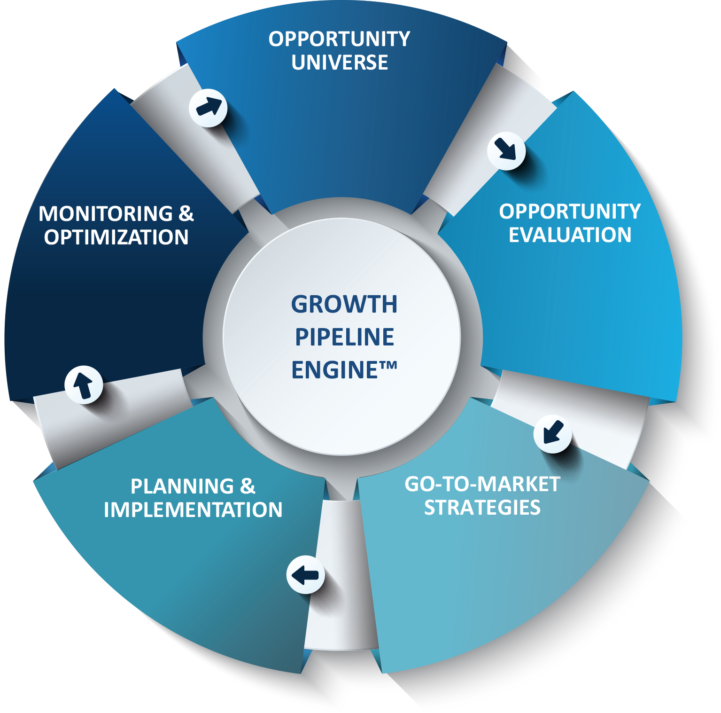
HOW THIS ENGAGEMENT FITS WITHIN THE GPAAS FRAMEWORK – OUR FOCUS
Phase 0: Growth Audit™
Establish organizational baseline & identify growth obstacles
Phase 1: Opportunity Universe
Ideation & prioritization of all potential growth opportunities
Phase 2: Opportunity Evaluation
Deep, 360⁰ analysis of prioritized opportunities
Phase 3: Go-To-Market Strategies
Translation of strategic alternatives into a cogent strategy
Phase 4: Planning & Implementation
Strategic plan execution (e.g., milestones, targets, owners, & deadlines)
Phase 5: Monitoring & Optimization
Adapt strategy to changing market dynamics & unearth new opportunities

Slide 13
THE GROWTH PIPELINE AUDIT™/ assessment
Phase 0
The Growth Pipeline Audit™ (GPA) is a Best Practices benchmark of your competencies across all stages of the Growth Pipeline™.
The GPA is a crucial first step in understanding your corporate readiness to implement the Growth Pipeline™, and to drive executive alignment around key growth attributes.
It is an essential activity that should take place annually to confirm core competencies and continuously leverage the Growth Pipeline™ process to stay ahead of competition.

Slide 14
THANK YOU
APOORV ANAND
APOORV.ANAND@FROST.COM
MOBILE: +91 9028889558

