Slide 1
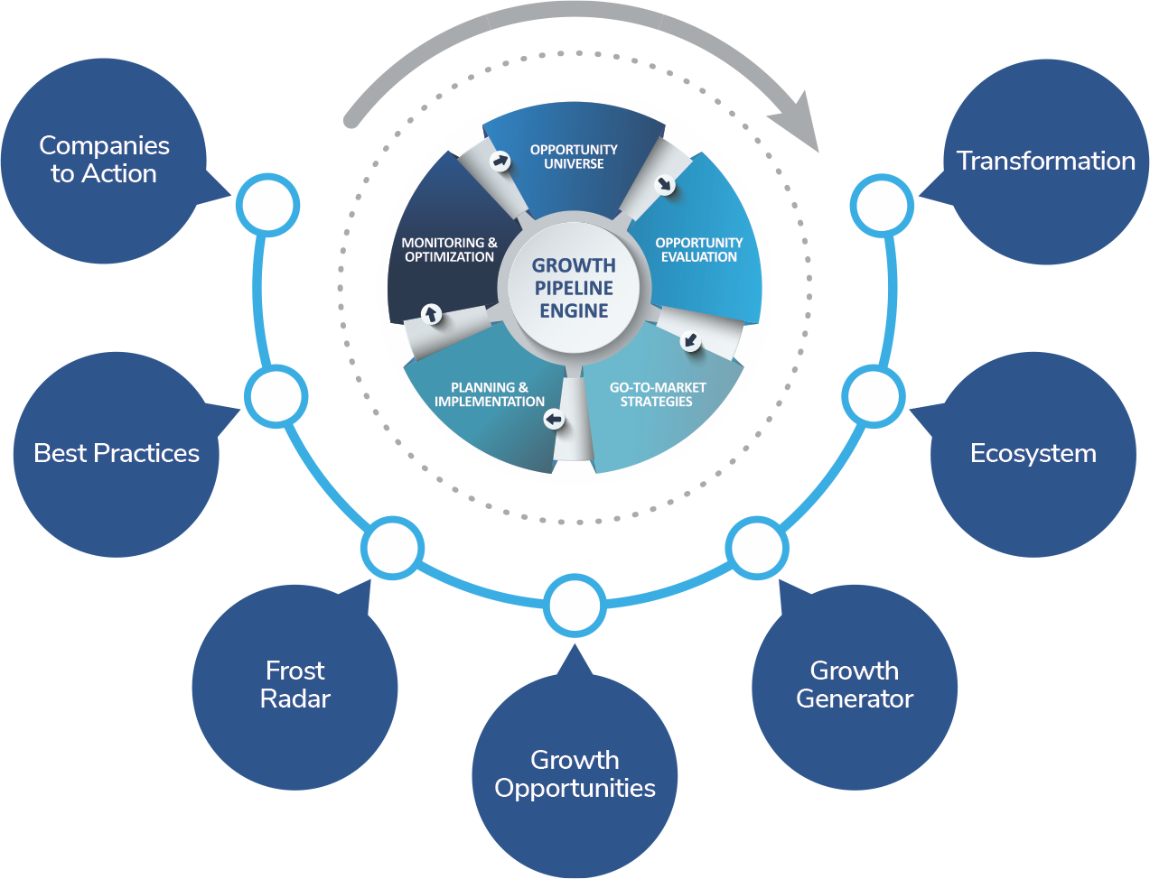
TRANSFORMATIONAL GROWTH JOURNEY
“Powered by the Growth Pipeline Engine”
Proposal
For
Sustainability 4.0 2025 Awards
Nomination Details
Is your team prepared for the coming Transformation?

Slide 2

Content
COMMERCIALS
TERMS & CONDITIONS
NOMINATION DETAILS
CONTACT DETAILS
AGREEMENT & DECLARATION
ANNEXURE

Slide 3
Commercials
CATEGORY | TURNOVER (Site/ Campus) | SUSTAINABILITY | SAFETY | DECARBONIZATION & WATER INDEX
*SGW – Pre-Assessment & Growth Workshop | ANY | ON REQUEST
EMERGING BUSINESS | 20 Cr – 100 Cr | INR 440,000 | INR 250,000 | INR 500,000
MEDIUM BUSINESS | 101 Cr – 500 Cr | INR 640,000 | INR 350,000
LARGE BUSINESS | 501 Cr – 2000 Cr | INR 740,000 | INR 495,000 | INR 650,000
MEGA LARGE BUSINESS | > 2000 Cr | INR 840,000 | INR 595,000
*SUSTAINABILITY GROWTH WORKSHOP
Note:.
100 % advance Payment.
The fees is exclusive of GST @ 18%.
Frost & Sullivan India Private Limited GST Number: 33AAACF4252A1ZE.
All to and fro air travel, local conveyance and lodging/boarding will have to be arranged and provided for the Assessors, by the company being assessed.

Slide 4
Content
COMMERCIALS
TERMS & CONDITIONS
NOMINATION DETAILS
CONTACT DETAILS
AGREEMENT & DECLARATION
ANNEXURE

Slide 5
TERMS & conditions
To nominate under the program, the company will have to process the advance 100 % fees (refer the commercials slide) along with the duly signed copy of this Proposal and Self Assessment Docket (SADOC) to block the dates for assessment.
All to and fro air travel, local conveyance and lodging/boarding will have to be arranged and provided for the Assessors, by the company being assessed.
The payment can be made by Demand Draft or Cheque in favour of “Frost & Sullivan India Private Limited” payable at Chennai. Payment can also be made by wire transfer (details of the wire transfer shall be shared upon request).
The Managing Committee of the awards program shall reserve all rights in finalization of the site assessment dates.
Applicable fees to be paid 100% in advance to block the assessment dates
Payment will be due immediate upon raising tax invoice.
Engagement will commence upon receipt of a signed Letter of Agreement (LOA) and the stipulated payment.

Slide 6
Content
COMMERCIALS
TERMS & CONDITIONS
NOMINATION DETAILS
CONTACT DETAILS
AGREEMENT & DECLARATION
ANNEXURE

Slide 7
Corporate Recognition : Yes No Number of Sites : 2 – 5 6 – 20 21 and above
Company details
Company Name
Nature of Business
Company GST Number
TAN Number
Address for Billing
LIST OF SITES/ campus BEING NOMINATED
Location Nominations
Sr. No. | Site/ Campus Location | Sales Turnover (in INR Cr) | Sustainability Assessment (Y/N) | Safety Assessment (Y/N) | Decarbonization & Water Index (Y/N)

Slide 8
Content
COMMERCIALS
TERMS & CONDITIONS
NOMINATION DETAILS
CONTACT DETAILS
AGREEMENT & DECLARATION
ANNEXURE

Slide 9
Contact details
Point of Contact for Correspondence:
Designation: | Email ID:
Phone: | Hand Phone:
Name of the Senior Most Official in the Company:
Designation: | Email ID:
Phone: | Hand Phone:
Name of the Authorizing Official:
Designation: | Email ID:
Phone: | Hand Phone:

Slide 10
Content
COMMERCIALS
TERMS & CONDITIONS
NOMINATION DETAILS
CONTACT DETAILS
AGREEMENT & DECLARATION
ANNEXURE

Slide 11
Agreement & Declaration
I state that this application represents the organization’s irreversible decision to participate in the complete awards process of Sustainability 4.0 Awards. We also understand that we shall have to pay the assessment fees in advance and abide by the terms and conditions as mentioned and arrange the site visit for the assessment team. By sharing the logo, we provide our consent to Frost & Sullivan to use the logo for current and future marketing/promotion purpose to showcase our esteemed company as a winner of S 4.0 program. The Assessment team will comprise of experts from Frost & Sullivan, Independent Consultants and Industry Assessors (Solution Providers) to add value to the assessment. The assessment fees is non-refundable and non-adjustable in subsequent cycle.
SIGNATURE OF AUTHORIZING OFFICIAL WITH SEAL: DATE:

Slide 12
Content
COMMERCIALS
TERMS & CONDITIONS
NOMINATION DETAILS
CONTACT DETAILS
AGREEMENT & DECLARATION
ANNEXURE

Slide 13
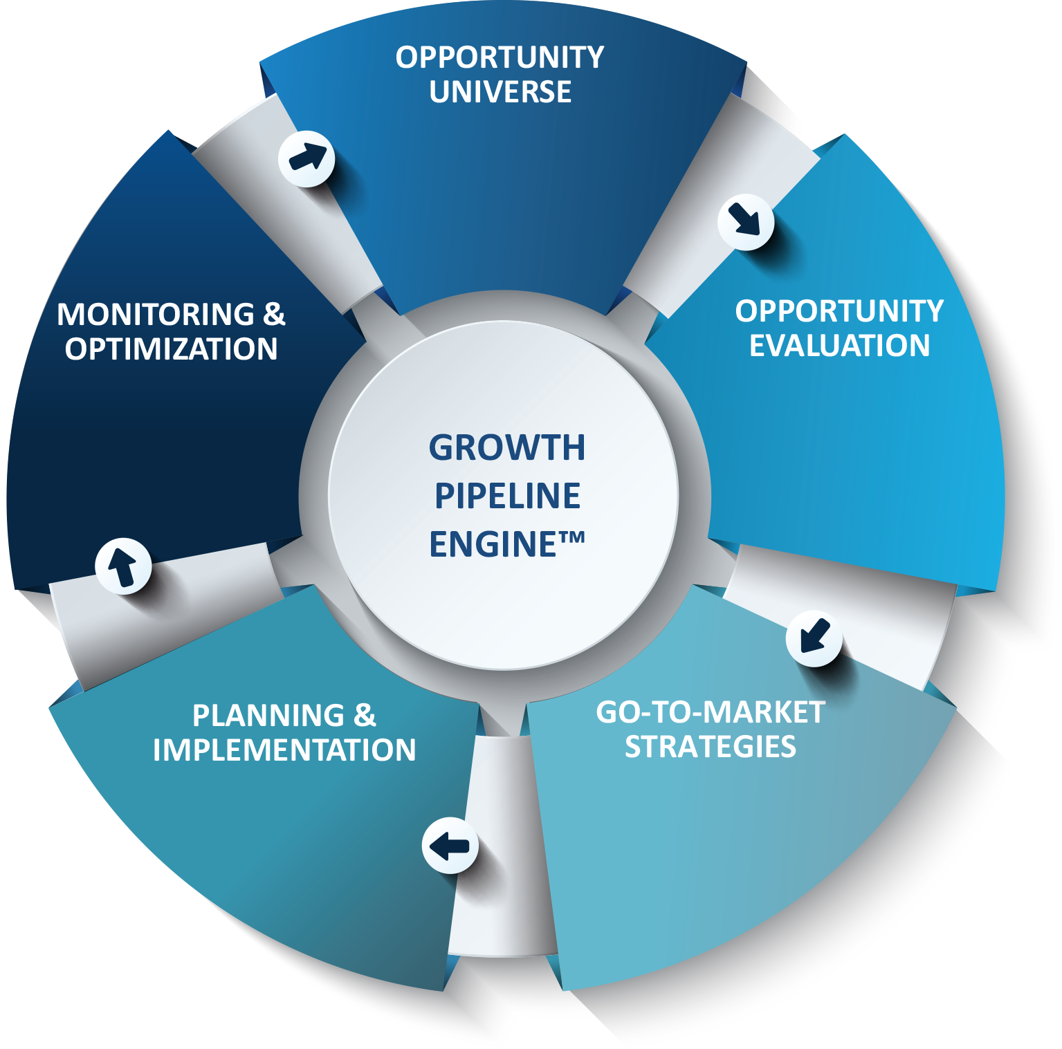
HOW THIS ENGAGEMENT FITS WITHIN THE GPAAS FRAMEWORK – OUR FOCUS
Phase 0: Growth Audit™
Establish organizational baseline & identify growth obstacles
Phase 1: Opportunity Universe
Ideation & prioritization of all potential growth opportunities
Phase 2: Opportunity Evaluation
Deep, 360⁰ analysis of prioritized opportunities
Phase 3: Go-To-Market Strategies
Translation of strategic alternatives into a cogent strategy
Phase 4: Planning & Implementation
Strategic plan execution (e.g., milestones, targets, owners, & deadlines)
Phase 5: Monitoring & Optimization
Adapt strategy to changing market dynamics & unearth new opportunities

Slide 14
THE GROWTH PIPELINE AUDIT™/ assessment
Phase 0
The Growth Pipeline Audit™ (GPA) is a Best Practices benchmark of your competencies across all stages of the Growth Pipeline™.
The GPA is a crucial first step in understanding your corporate readiness to implement the Growth Pipeline™, and to drive executive alignment around key growth attributes.
It is an essential activity that should take place annually to confirm core competencies and continuously leverage the Growth Pipeline™ process to stay ahead of competition.

Slide 15

THANK YOU
Apoorv Anand
Mobile: 9028889558
Email: Apoorv.anand@frost.com
The Growth Pipeline™ Company
Powering clients to a future shaped by growth

